Slide 1
Front End Engineering-I Project
Team Details:Parvesh 2310991011
Parth Sidana 2310991010
Peraval Sharma 2310991012
Faculty Coordinator:Dr Neeraj Singla
:
Chitkara University Institute of Engineering and Technology,
Chitkara University, Punjab

Slide 2
Table of Contents
Introduction
Problem Statement
Technical Details
Key Features
Project Highlights
References/Links used

Slide 3
Introduction
RECIPE SHAREING PLATFORM
An Online Food Recipe website is a platform that allows users to share and access food recipes from different cuisines worldwide.These websites provide a vast collections of easy-to-follow recipes for various dishes from appetizers to main cources to deserts.

Slide 4
Problem Statement
This slide should clearly state the problem that the project aims to solve, including any relevant background information and research.

Slide 5
Technical Details
Front-End Technologies: The Word Counter project's user interface is built using a combination of HTML for structure, CSS for styling, and JavaScript for interactivity. HTML: HTML (Hypertext Markup Language) is used to create the structure of the user interface. CSS: CSS (Cascading Style Sheets) is employed to style and format the user interface, ensuring a visually appealing and user-friendly design. JS:JS(Java Script) is a scripting language used to develop web pages. JS allows developers to
Create a dynamic and interacting web page.

Slide 6
Key Features
-Variety of recipes available
-You can add some of yours Recipes
-You can save your favourite recipes

Slide 7
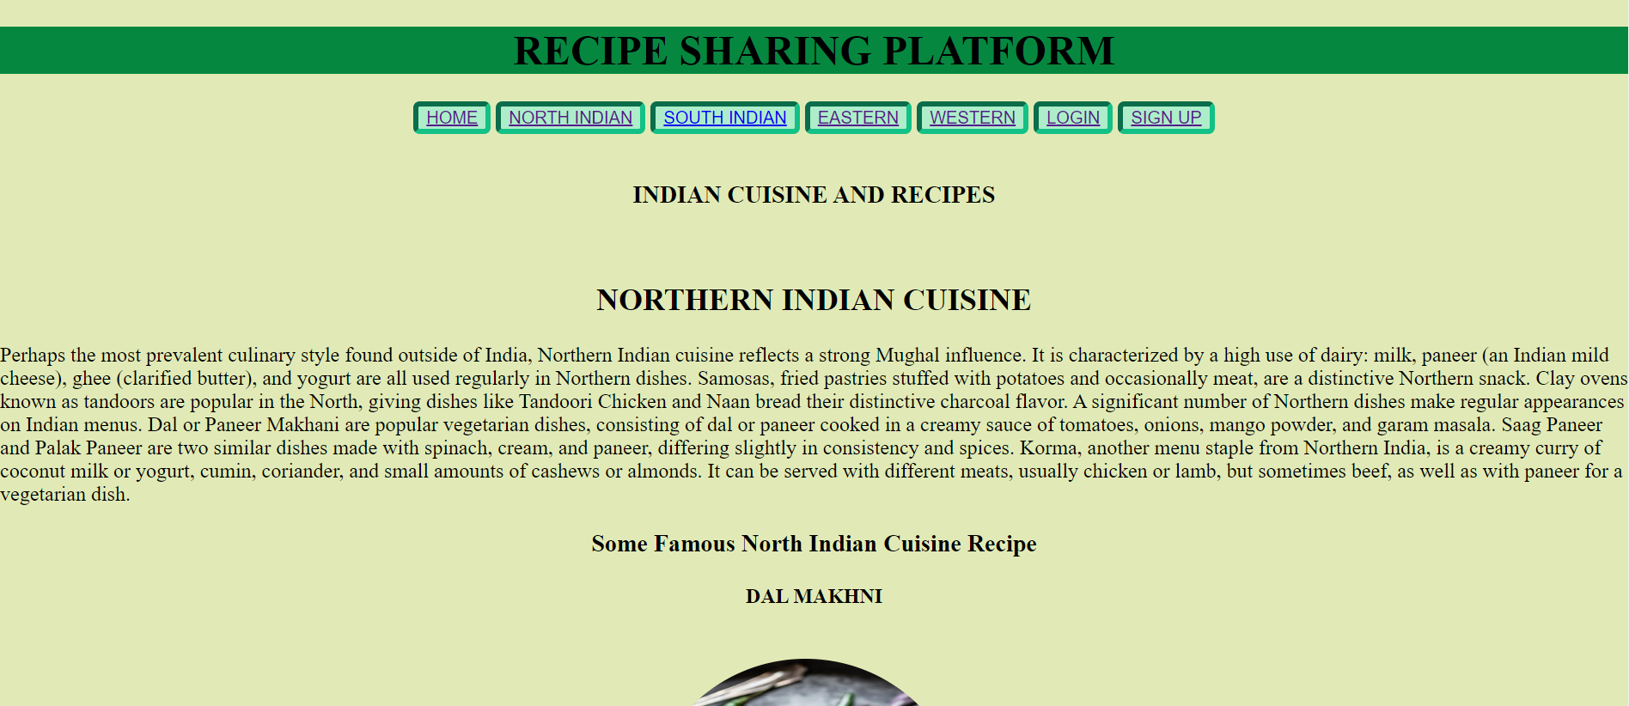
Project Highlights

Slide 8
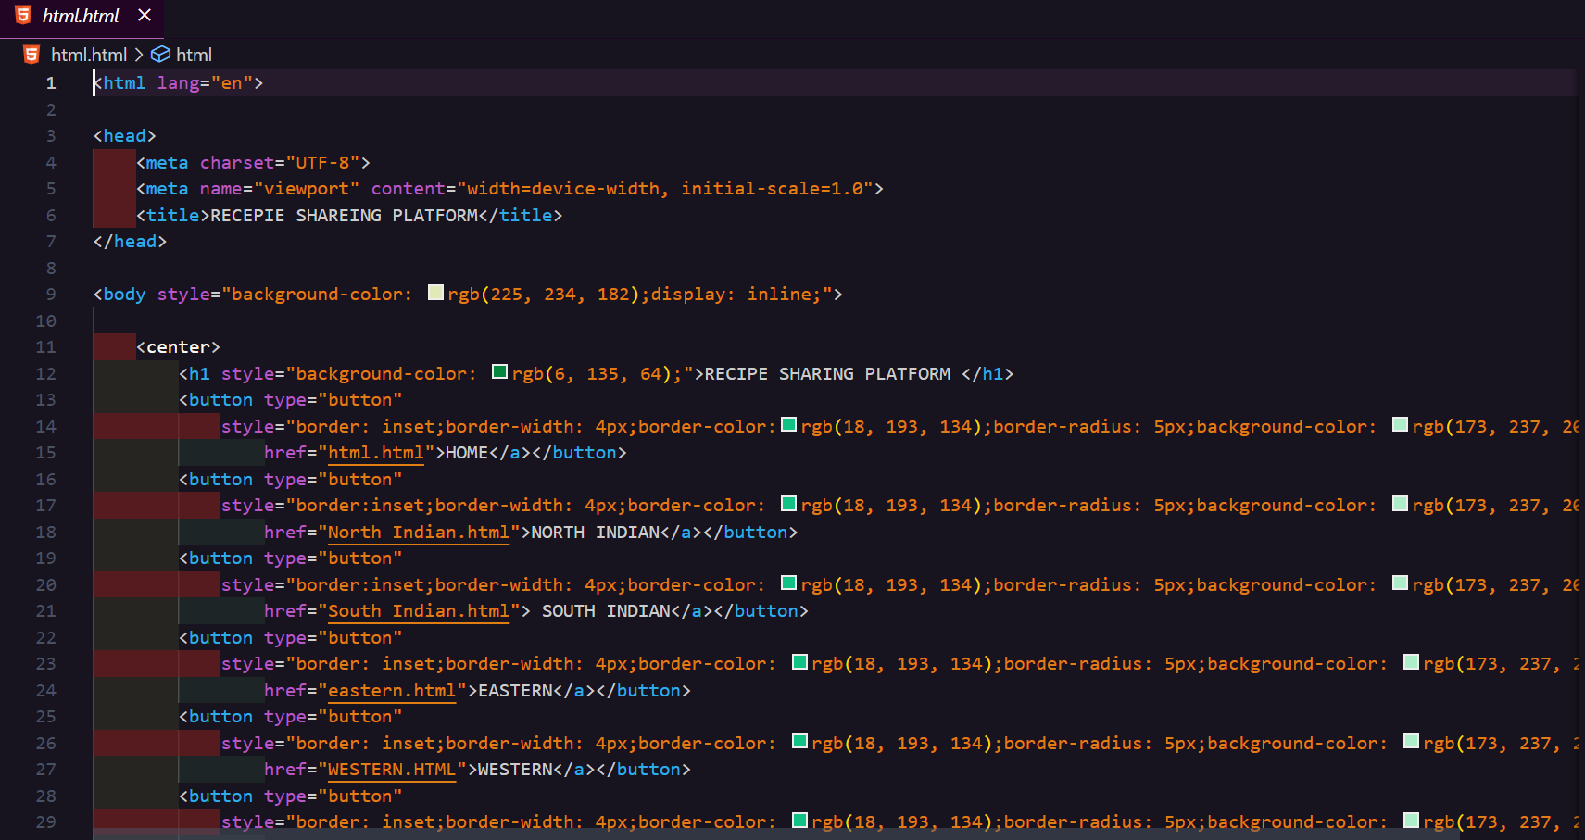

Slide 9
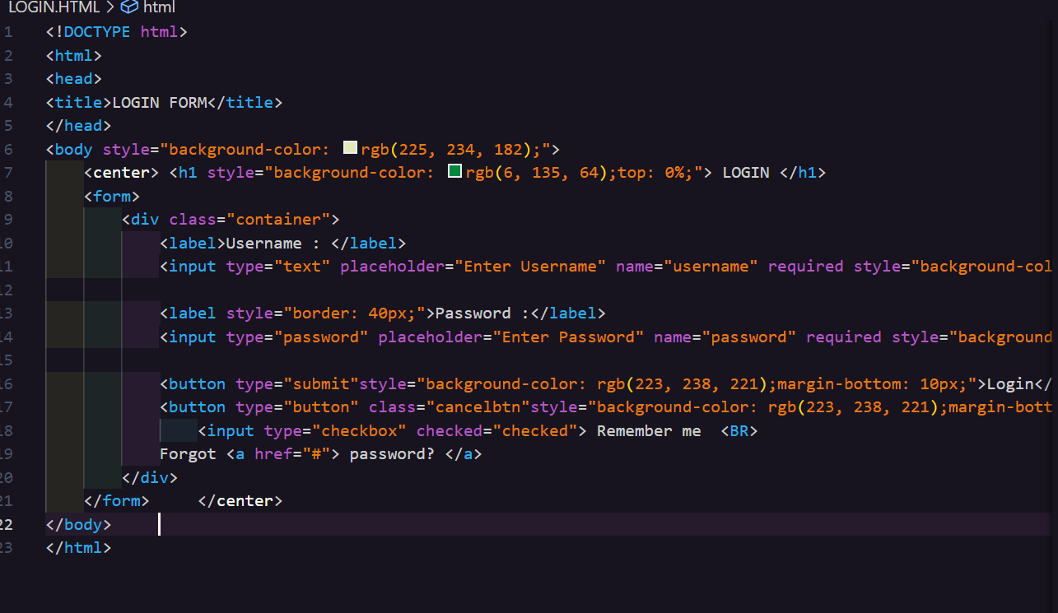

Slide 10
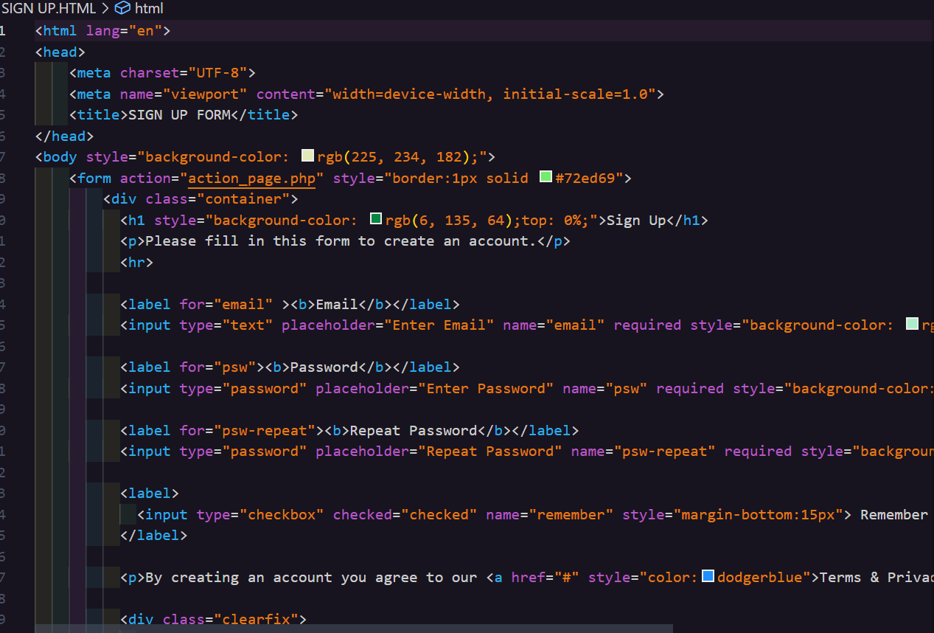

Slide 11
References/Links used
-https://getbootstrap.com/docs/5.3/getting-started/introduction/
-https://www.peerbits.com/case-studies/frimb-food-drink-app.html

Slide 12


